Slide 1
SenecaSync Project: Enhancing Digital Academia at Seneca College
Final Project Report Overview.
Presented by Mohsen Sabet ,Project Manager
IT Project Management Fundamentals

Slide 2
TABLE OF CONTENTS
01
02
Project Objectives
Project Scope and Deliverables
03
04
Major Project Activities
Project Assessment
05
06
Summary of Risks and Mitigation
Lessons Learned

Slide 3
PROJECT OBJECTIVES
Enhance Student Academic Experience
Seamless Integration
Improve Academic Efficiency
Mobile-First Design

Slide 4
PROJECT SCOPE AND DELIVERABLES
SCOPE
DELIVERABLES
Adaptive
Notifications
Customizable
User Profiles
Feedback
Integration
SenecaSync Mobile App
Blackboard Ultra Integration
User Support Materials
Interactive
Dashboard
Deep Linking
to
Blackboard Ultra

Slide 5
MAJOR PROJECT ACTIVITIES
MILESTONE 1
MILESTONE 3
MILESTONE 5
MILESTONE 7
Planning and Analysis
Development Phase
Deployment and Implementation
Support and
Maintenance
MILESTONE 2
MILESTONE 4
MILESTONE 6
Design of User Interface
Testing and Quality Assurance
Marketing and User Training

Slide 6
WORK BREAKDOWN STRUCTURE
SenecaSync Project
Project Initiation
Requirement Gathering
Design
Development
Testing
Deployment
Marketing & Outreach
Maintenance & Support
Project charter creation
Team assembly
Initial stakeholder meeting
Conduct student surveys
UX/UI design
Set up development environment
Unit testing
Prepare deployment environment
Develop marketing strategy
Monitor app performance
Meet with faculty for input
Technical requirements from IT department
Collate and finalize requirements document
Initial mockups
User feedback sessions
Finalize designs
System architecture design
Database design
Front-end development
Back-end development
Integration with Blackboard Ultra
Initial testing and debugging
Integration testing
User acceptance testing (UAT)
Bug fixing and retesting
App deployment
User training sessions
Go-live
Create promotional materials
Launch event or promotion
Gather initial user feedback post-launch
Address any reported issues
Regular updates based on user feedback
Continuous improvement

Slide 7
PROJECT ASSESSMENT
Effective Planning and Strategy
Risk Management Approaches
Schedule Adherence
Stakeholder Engagement

Slide 8
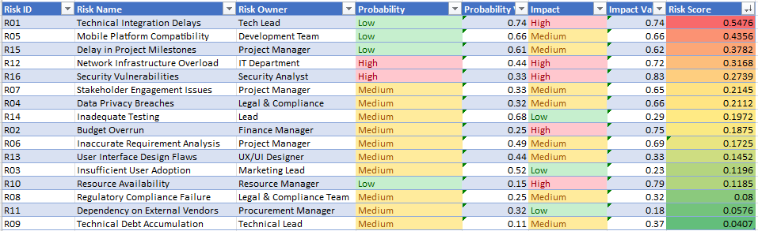
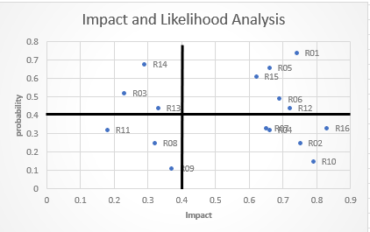
SUMMARY OF RISKS AND MITIGATION
RISKS
Technical Integration Delays
Mobile Platform Compatibility
Delay in Project Milestones
Data Privacy and Security Concerns

Slide 9
LESSONS LEARNED
Adaptability and Flexibility
Effective Communication
Planning and Analysis
Risk Management

Slide 10
THANKS!

